Slide 1

CSS Level Two
CSS - Level Two

Slide 2
Django Bootcamp
Welcome to CSS Level Two!
In this section of the course we will continue to expand our knowledge of CSS by learning about Fonts and the Box Model

Slide 3
Django Bootcamp
This will be a shorter section, but at the end we will have a project for you!
Let’s get started!

Slide 4
CSS Level Two - Part 1
CSS - Level Two

Slide 5
Django Bootcamp
In this lecture we will learn about font properties with CSS, such as size,weight, text alignment, etc.
We will also learn how to download and change fonts.

Slide 6
Django Bootcamp
When dealing with fonts, we have to keep in mind that not every OS has every font!
We may need to provide the font for our website.

Slide 7
Django Bootcamp
Because of this we will be exploring a few links:
OS support for certain fonts
Downloading fonts
Let’s start by showing some basic font properties with CSS!

Slide 8
CSS Level Two - Part 1
Continued
CSS - Level Two

Slide 9
Django Bootcamp
In the last lecture we showed some basic CSS properties for fonts, now let’s explore how to understand OS choice and font
We will also show how to use custom web fonts.
Let’s get started!

Slide 10
CSS Level Two - Part 2
CSS - Level Two

Slide 11
Django Bootcamp
In this lecture we will learn about the CSS box model.
The box model allows us to precisely dictate how we want HTML elements to look.

Slide 12
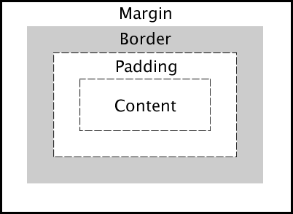
Django Bootcamp
The basic box model looks like this:

Slide 13
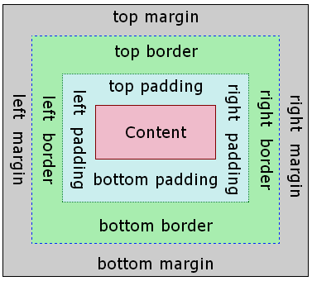
Django Bootcamp
But you can also specify each side:

Slide 14
Django Bootcamp
Let’s explore some examples of this!

Slide 15
CSS Level Two
Spectrum Project
CSS - Level Two

Slide 16
Django Bootcamp
For this project you will be digitally recreating your own version of the art piece known as Spectrum V , by Ellsworth Kelly.
It is currently located at the MET in New York City, let’s take a look!

Slide 17
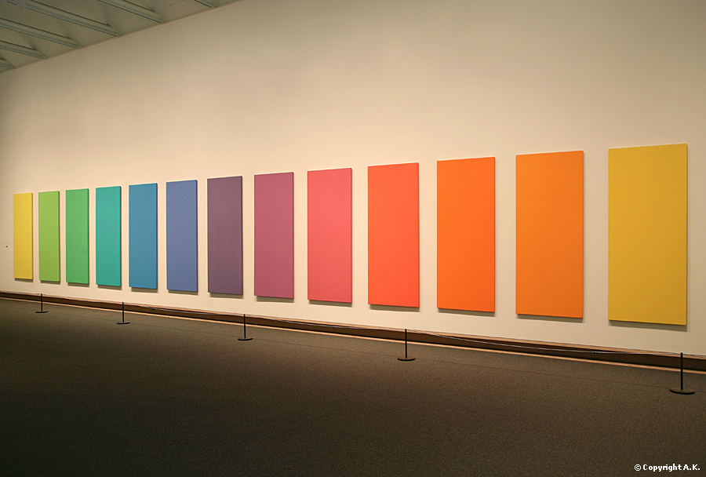
Django Bootcamp
Spectrum V by Ellsworth Kelly

Slide 18
Django Bootcamp
You will be creating your own smaller version for a webpage, using what you’ve learned about the box model.
You will also pick a color palette to use.
Let’s take a look at an example!

Slide 19
CSS Level Two
Spectrum Project Solutions
CSS - Level Two

